Slide 1
Visualization of creative works
by Ukrainian writers from Galicia
in the books and periodicals of the 19th c. – 1939
Lilija Syrota

Slide 2
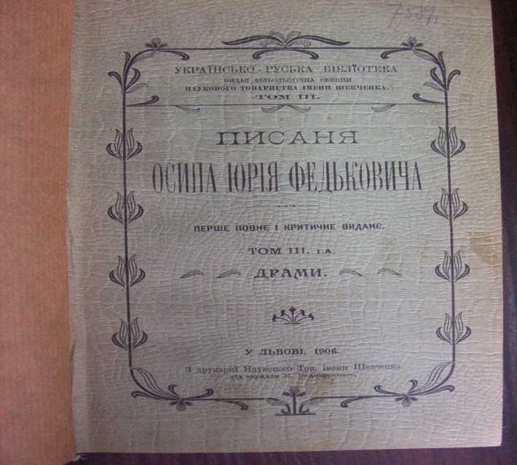
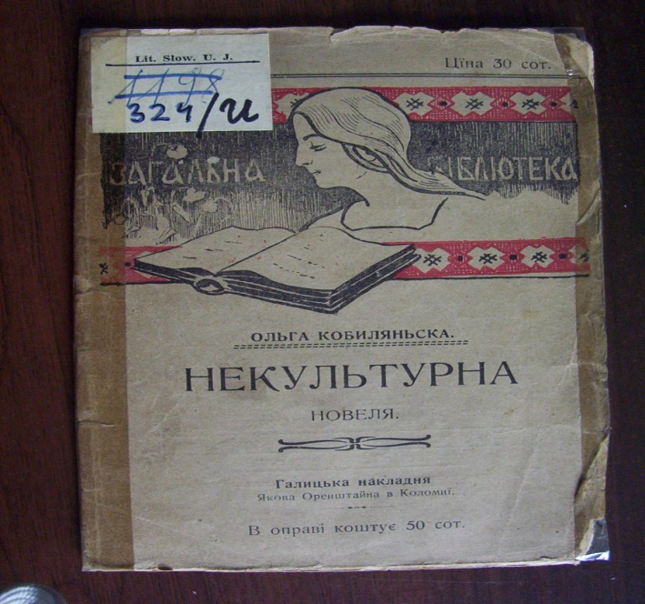
The print editions, and in particular, literary publications, played an important role in life of any nation in the end of XIX–1939th. In this period a novels and a stories was printed along with social, economical, juridical, environmental topics in a book series and journals. Only some books and journals were illustrated in the XIX century. Mainly drawings, photos or ornaments had to testify the uniqueness of this edition. Appreciation of the importance of illustrative material was not unanimous, particularly with regard to the illustration of children's texts.

Slide 3
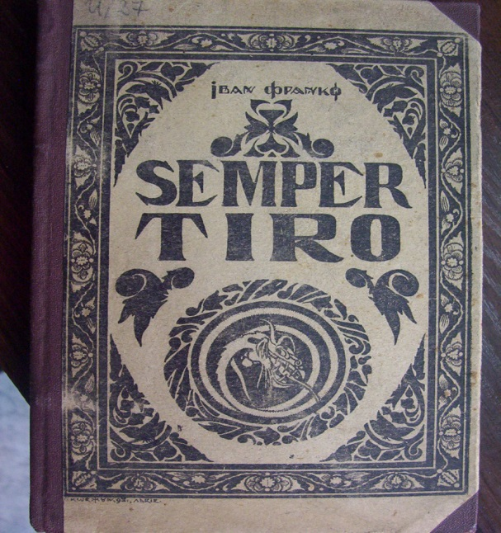
In this period graphic information was placed on the cover of the book. Pinnacle publishing production of Lviv until 1914 can be considered the anthology of Ukrainian lyrics "Accords" (1903), which Yulian Pankevych had illustrated. Numerous floral and geometric patterns, intros, endings, the first letters of the verses, miniatures and paintings were revealed the contents of the works of Ukrainian classics and modernists.

Slide 4
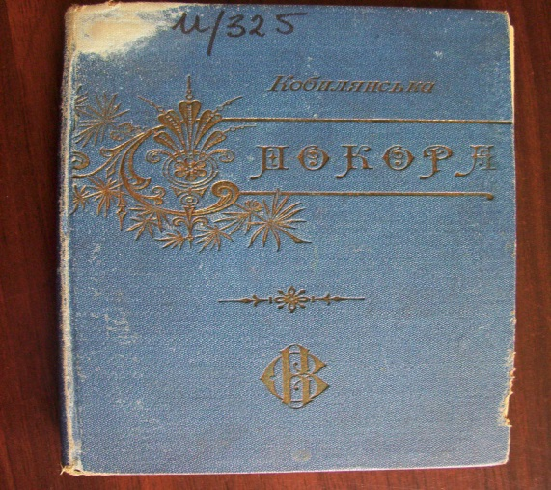
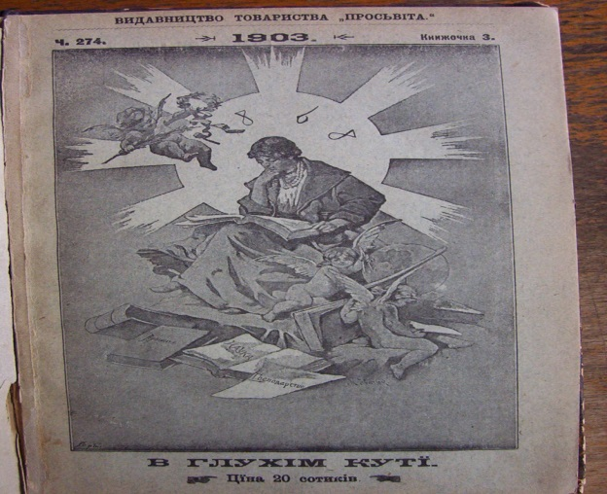
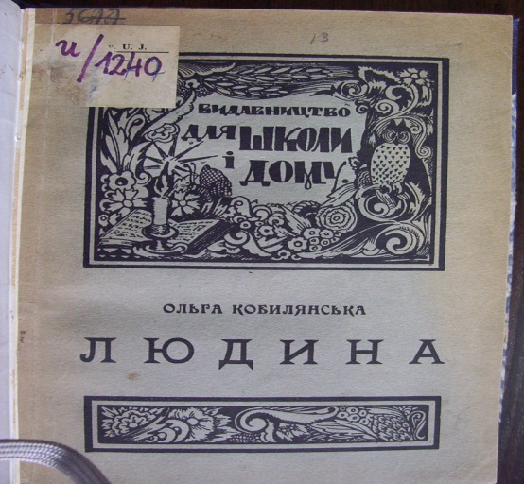
The majority of printed materials were issued on the basis of the following principle: the illustration was not coordination with the opinion of an author of a literary work, that was printed in the book series. Its publishers were not members of a literary groups – they were with the society "Enlightmen", the Ruthenian pedagogical society, the Ukrainian-Ruthenian publishing Company, etc. Characteristic features of books were the immutability of the cover design in a series (a schematic-symbolic picture-cliche), the lack of funds that had led to the sparingly using of drawings, photos, reproductions. The first page of the cover, as a rule, were decorated with a border of ornament.

Slide 5
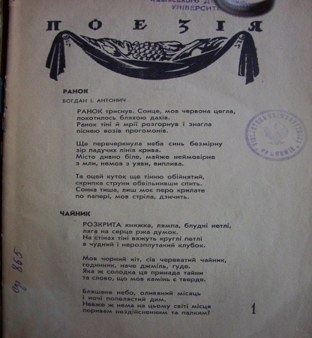
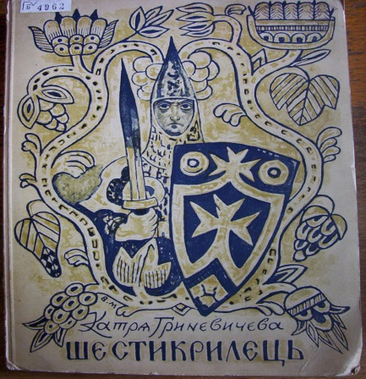
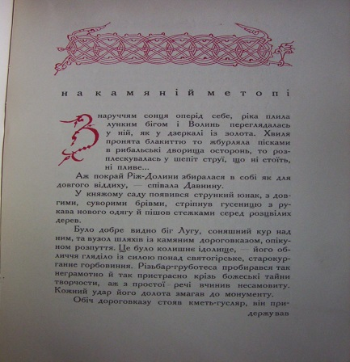
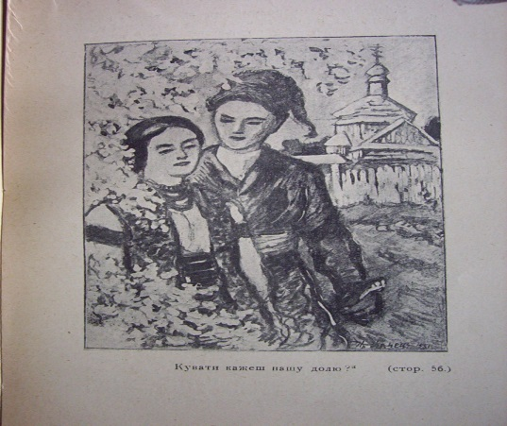
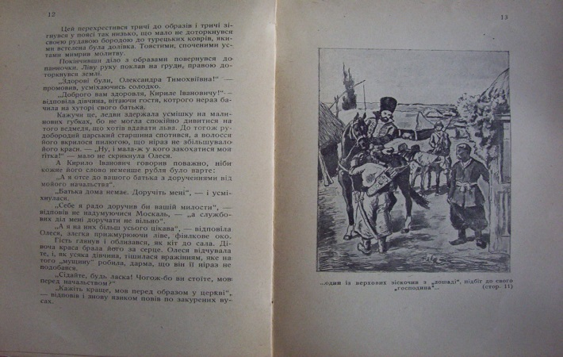
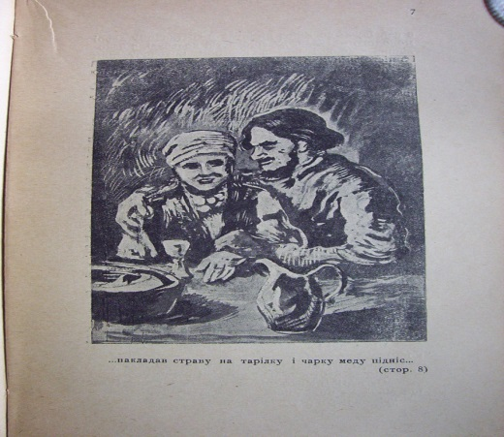
Volodymyr Lasowski depicted smoldering fuzzy contour of a school notebook, through which, as if through a window, clearly see the future, embodied in the symbolic urban landscape. The inscription "Antonych" and "Rotation" ' is also a kind of antithesis, with the use of italics and a clean, straight font.

Slide 6
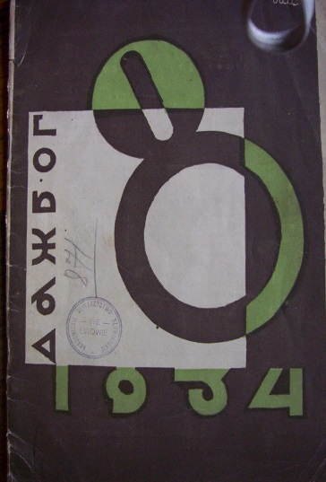
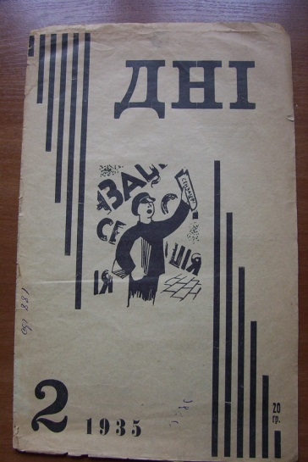
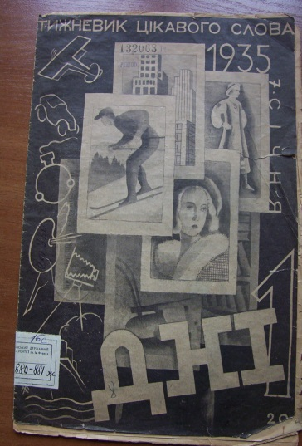
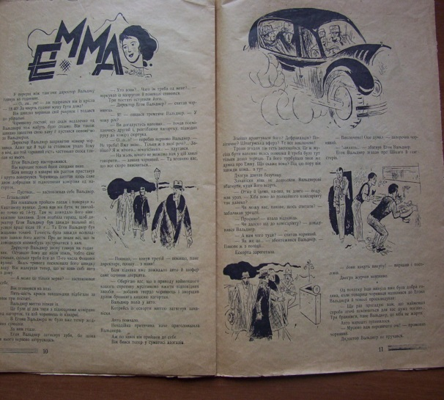
The majority of Ukrainian publishers in Lviv in the interwar period cooperated more closely with artists. A mandatory element of the books was the bibliography about the this book and the information about the Illustrator too. Innovative was that the illustrations did not have frames, they are freely placed on the page (at the top, middle or bottom of the page) and they were one with the text. Having its own substance and logic of placement out of the text, illustrations could inform about a certain feature of human relations. An important element of the visualization of literary material was saver to parts of individual works or sections of journals. P. Kovzhun was often author of the savers to the rubrics of literary journals, graphics to the works of Ukrainian classics, such as Ivan Franko. The principle of combining various narrative elements was used in the collection of B. I. Antonych "Rotation".

Slide 7
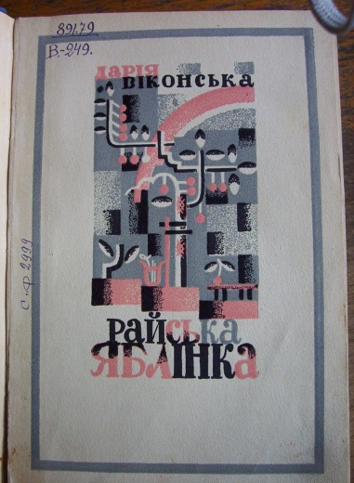
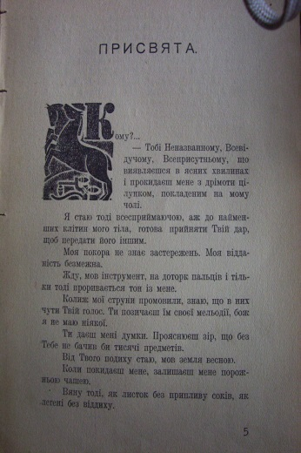
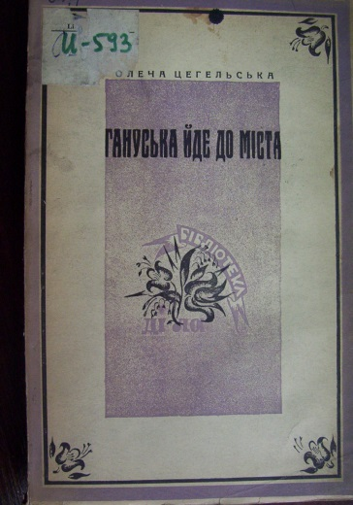
As in the XIX century, the purpose of illustrated book cover – to focus on national motifs works. Choosing the main character for the all the drawings of nature, man and city, the artists revealed the peculiarity of the national mentality, variability of time, invincibility of the people. Select book cover of the P. Kovzhun to the collection O. Babij "The Poetry" (1923). B. Grinchenko "The Sunlight" (1924) and D. Vikonska "The Paradise Apple Tree" (1931), S. Hordynsky to the stories of I. Kernitsky "The Night Lights of St. Ivan" (1934), R. Chornij to the poem O. Babij "The Lastest victim for Caesar" (1937), E. Kozak to the story of Hieronymus Anonymous "Lemko destiny" (1939), the book cover of P. Obal to the journal "Dazhbog" (1933), and others with the very conventional landscape and portrait.

Slide 8
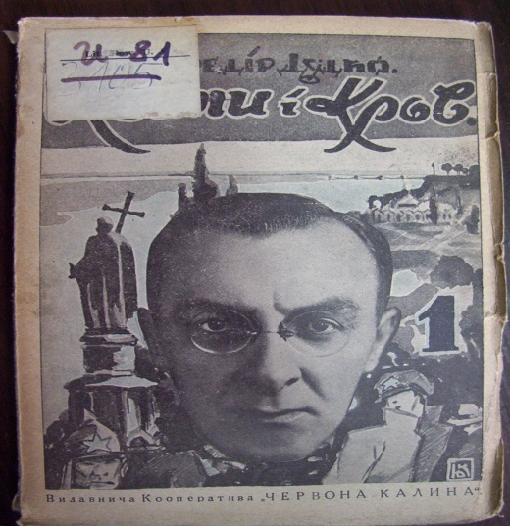
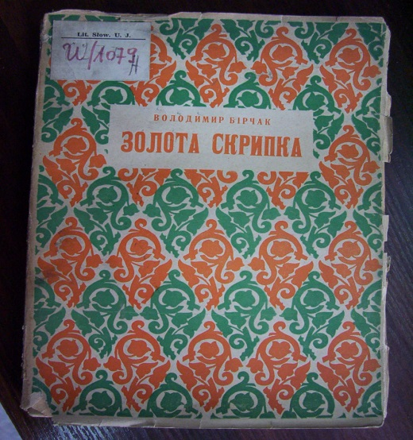
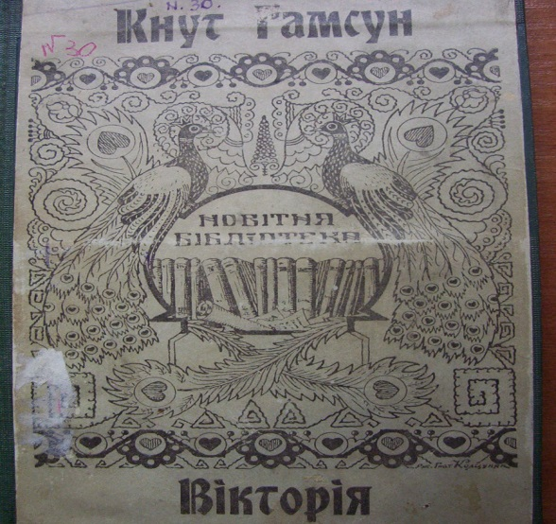
As you see, the Ukrainian publishers have paid a lot of attention on a process of an illustration of the books and journals. They had work in cooperation with artists whose drawings have been closely connected with the contents of poetry, novels and stories. Approach of artists was based on the ideas of integrity of the book contents and on attention to details also. Artists tried deep to disclose poetic and philosophical content in literary works and the ideas of the Ukrainian vanguard as literary movement. .

Slide 9
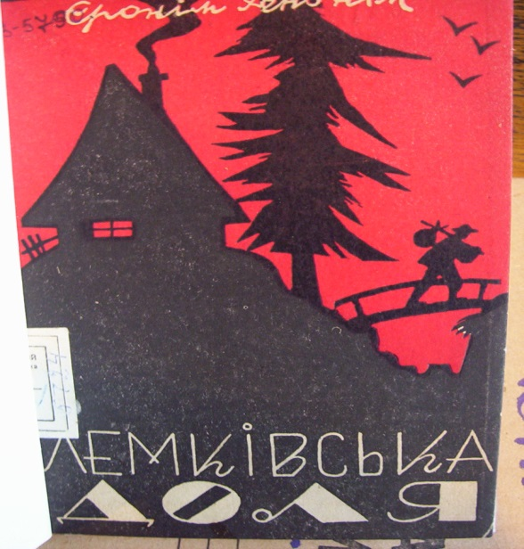
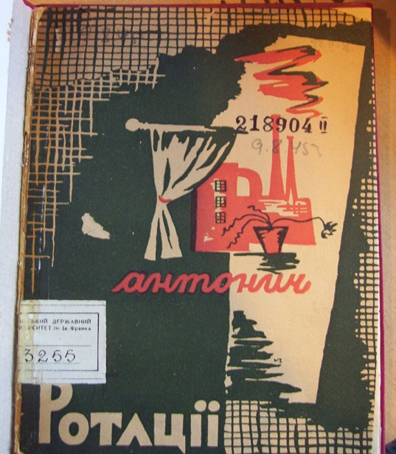
The visualization that was mainly concentrated on skilful design of cover of book and magazine or in drawings to texts of joutnals, gives an opportunity to see an evolution and feature of Ukrainian book illustrations. Content of illustration was always directed to the stylization of national elements, to the using of a symbolism of objects, figures, nature and their colors, to the simplified realistic or romantic image. With the help of illustrations a Ukrainian editions became more unique and interesting.

